Slide 1
Effective Prediction of Bankruptcy using Fuzzy Logic and Neural Networks
Sai SuDHeep Reddy KaiDAPuRam
Sai Dixit Tabdil

Slide 2
Table of Contents
Introduction
Data Collection
Parameters
Implementation
Fuzzy Logic
GENFIS using FCM clustering
Neural Network
Summary
Future work
References

Slide 3
Introduction
Finance sector is one of the industry that requires meticulous risk and credibility assessment system.
Risk assessment is critical because the complicated network of mutual credit obligations can make the actual risk exposure of the entire system invisible at the level of individual institutions.
It helps prevent an individual or an organization from committing into something that might cause extreme harm monetary or in any form.
So, there is a need of efficient methods to predict risk assessment.
In order to predict bankruptcy, we have used fuzzy logic and neural networks in this project.

Slide 4
Data Collection
The Qualitative Bankruptcy dataset is acquired from the UCI Machine Learning repository.
The dataset contains 6 qualitative parameters.
Industry risk
Management risk
Financial flexibility
Credibility
Competitiveness
Operating risk
The dataset contains 250 instances and 2 classes which is Bankruptcy(B) and Non-Bankruptcy(NB).

Slide 5
Input Parameters
Industry risk (IR) :
Government policies and International agreements
Degree of competition
The price and stability of market supply
The size and growth of market demand
Management risk(MR):
Ability and competence of management
Stability of management
Human resources management
Growth process/ Business performance
Short and long term business planning
Achievement and feasibility

Slide 6
Input Parameters
Financial Flexibility(FF):
Direct financing,
Indirect financing,
Other financing
Credibility (CR):
Credit history,
reliability of information,
The relationship with financial institutes.
Competitiveness (CO):
Market position,
The level of core capacities,
Differentiated strategy,
Operating Risk (OP):
The stability and diversity of procurement,

Slide 7
Mamdani Fuzzy Inference System
Steps followed in Mamdani FIS:
Fuzzifying the inputs using the input membership functions
Defining fuzzy rule base
Combining the fuzzified inputs according to the fuzzy rules to establish a rule strength
Finding the consequence of the rule by combining the rule strength and the output membership function,
Combining the consequences to get an output distribution
Defuzzifying the output distribution (this step is only if a crisp output (class) is needed).

Slide 8
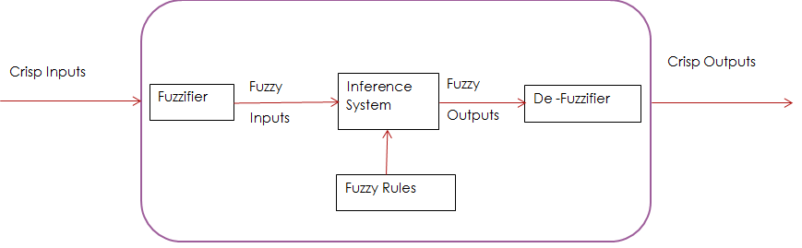
Mamdani Fuzzy Inference System

Slide 9
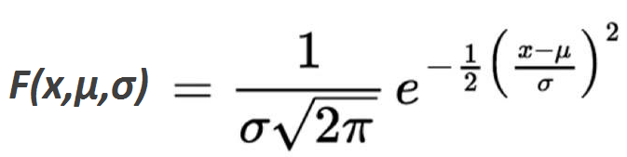
Industry risk and management risk fuzzy set
Industry Risk Fuzzy Set | Range | Membership Function
Positive | [0,10] | [1.36 9.097]
Average | [0,10] | [1.7 4.947]
Negative | [0,10] | [1.7 0.7937]
Gaussian Membership Function
Management risk Fuzzy Set | Range | Membership Function
Positive | [0,10] | [1.7 9.548]
Average | [0,10] | [1.7 7.412]
Negative | [0,10] | [1.71 2.46]

Slide 10
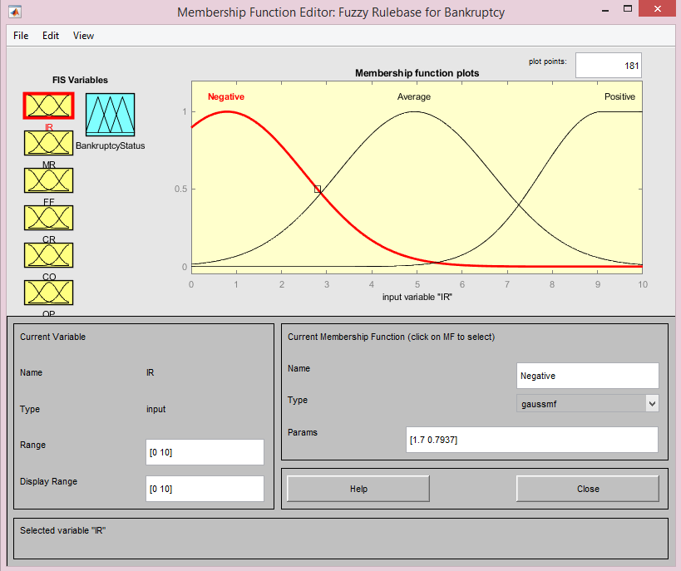
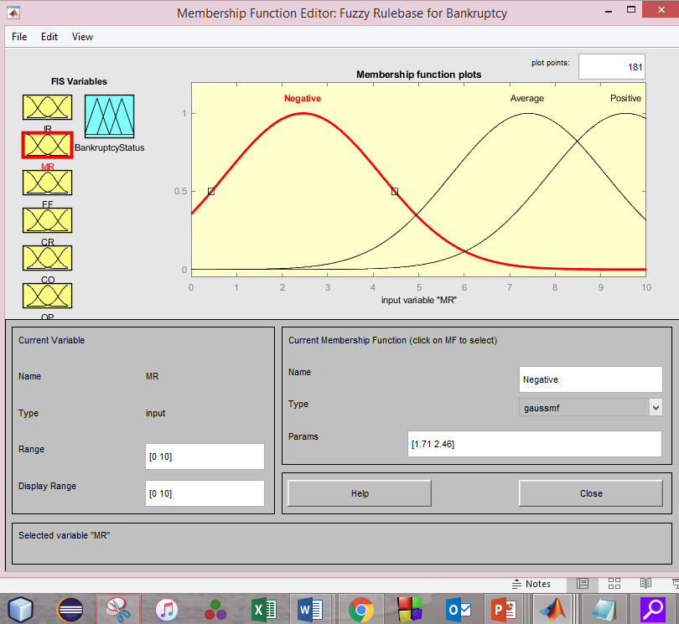

Slide 11
Financial flexibility and credibility fuzzy set
All the membership functions are gaussmf.
Financial flexibility risk Fuzzy Set | Range | Membership Function
Positive | [0,10] | [1.7 7.354]
Average | [0,10] | [1.7 6.028]
Negative | [0,10] | [1.7 2.116]
Credibility Fuzzy Set | Range | Membership Function
Positive | [0,10] | [1.7 9.55]
Average | [0,10] | [1.7 6.111]
Negative | [0,10] | [1.7 0.7937]

Slide 12
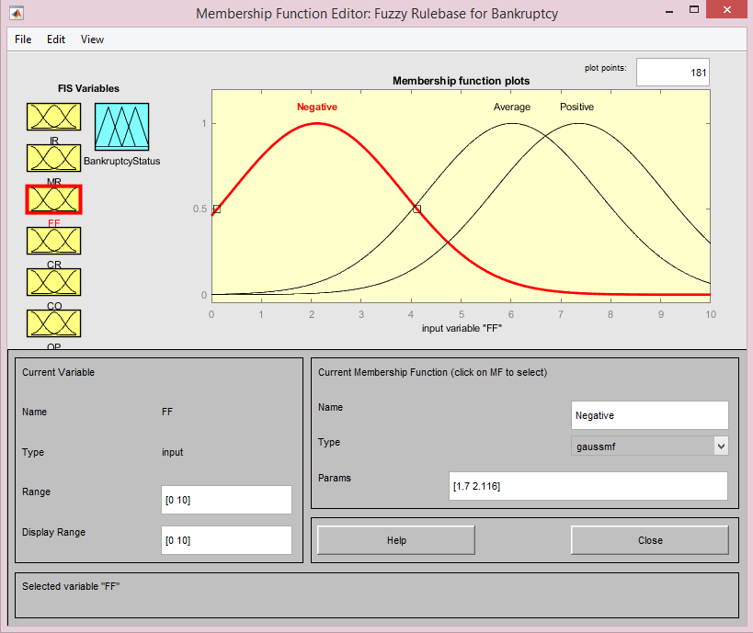
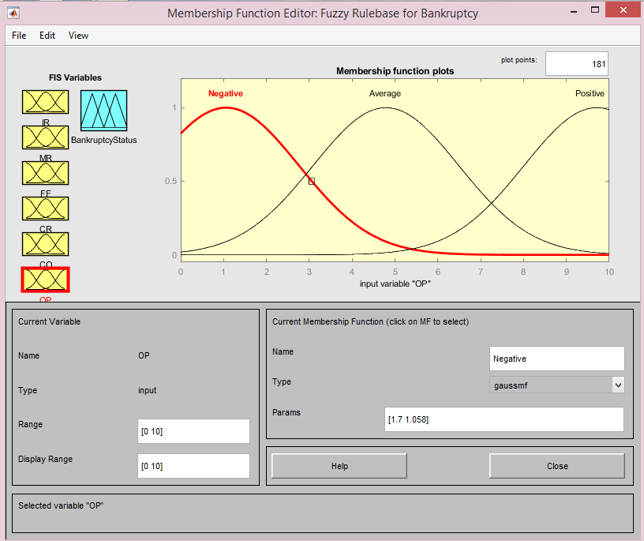

Slide 13
Competitiveness and Operating risk Fuzzy set
Competitiveness Fuzzy Set | Range | Membership Function
Positive | [0,10] | [1.7 9.077]
Average | [0,10] | [1.7 5.238]
Negative | [0,10] | [1.7 0.6349]
Operating risk Fuzzy Set | Range | Membership Function
Positive | [0,10] | [1.7 9.709]
Average | [0,10] | [1.7 4.788]
Negative | [0,10] | [1.7 1.058]

Slide 14



Slide 15
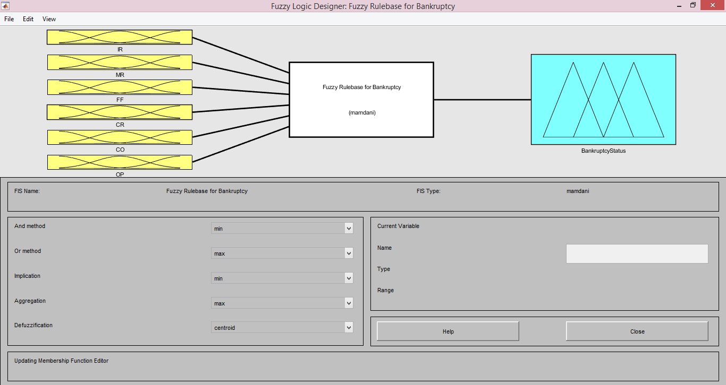

Slide 16
Bankruptcy status fuzzy set
Bankruptcy status Fuzzy Set | Range | Membership Function
Bankrupt | [0,10] | [1.062 2.5]
NonBankrupt | [0,10] | [1.062 7.5]

Slide 17
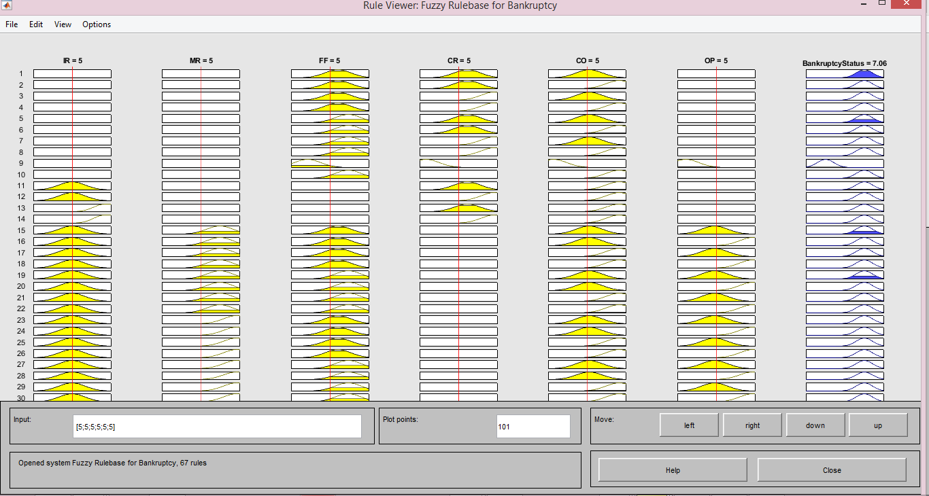

Slide 18
Example
Inputs
IR = 5
MR = 5
FF = 5
CR = 5
CO = 5
OP = 5
Output (Using Centroid Deffuzzifier):
Bankruptcy Status = 7.06 (High chances of bankruptcy)
So, lesser the risks, lesser the chances of Bankruptcy.

Slide 19
Fuzzy Inference Systems
There are many clustering algorithms for generating fuzzy inference systems.
Some of the clustering algorithms are as follows.
Grid Partitioning
Fuzzy C-Means Clustering.
Subtractive Clustering.
We have used Fuzzy C-Means clustering with Mamdani Fuzzy System type.

Slide 20

Fuzzy C-Means Clustering
It is also known as soft clustering.
In this clustering, a point can belong to more than one cluster.
This algorithm works by assigning membership to each data point corresponding to each cluster center on the basis of distance between the cluster center and the data point.
The main objective of this algorithm is minimizing the following.
'||x_{i} – v_{j}||' is the Euclidean distance between i^{th} data and j^{th} cluster center.
'µij' represents the membership of i^{th} data to j^{th} cluster center.

Slide 21
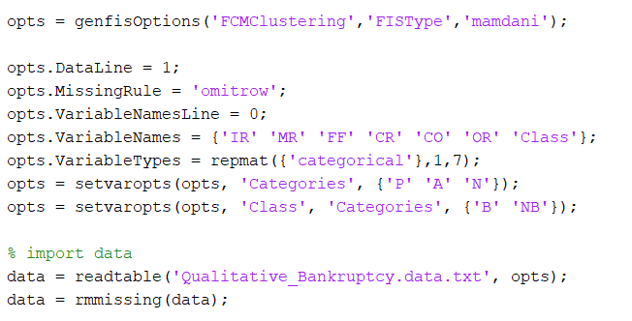
Fuzzy Inference system using FCM Clustering Implementation
Pseudo Code:

Slide 22
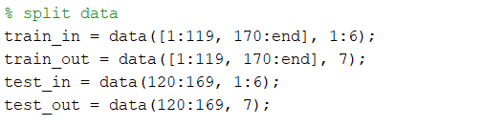
Training and Testing Data
The dataset is divided into training set and testing set.
Usually, training data is in greater quantity than testing set.
In this project, 80% is training data and 20% is testing data.
The following pseudo code shows partitioning of data.

Slide 23
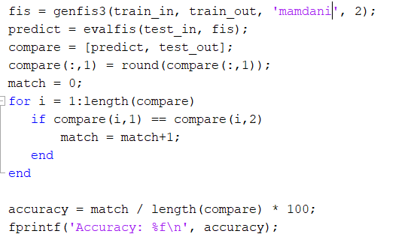
Building FIS and evaluation of results
Pseudo Code:

Slide 24
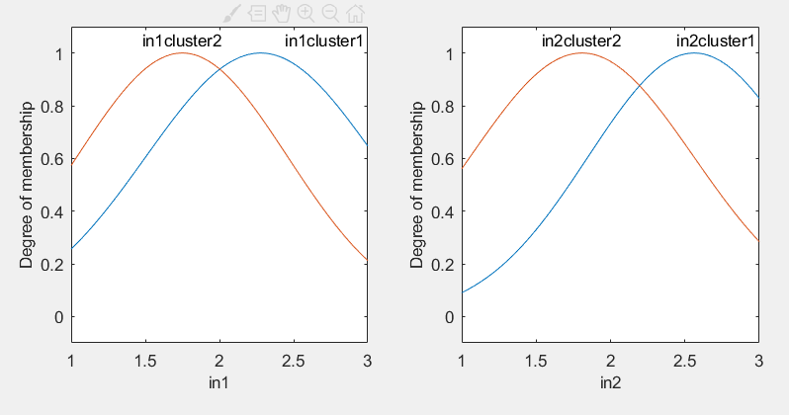
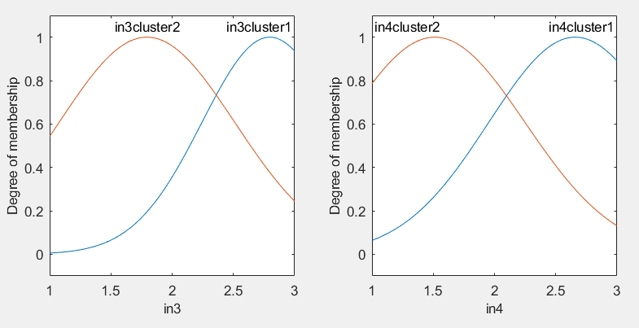
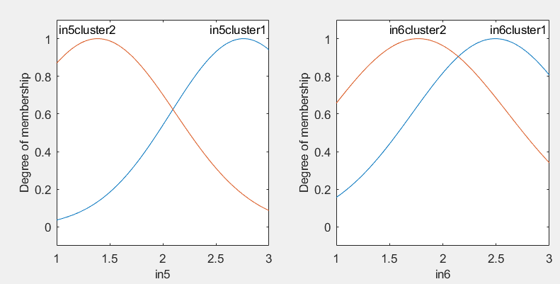
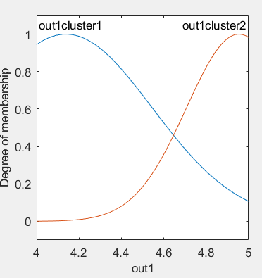
Membership Functions

Slide 25
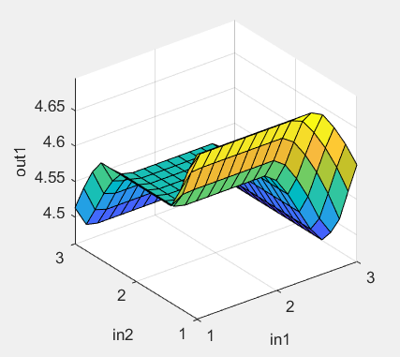
Fuzzy Inference System with FCM clustering

Slide 26
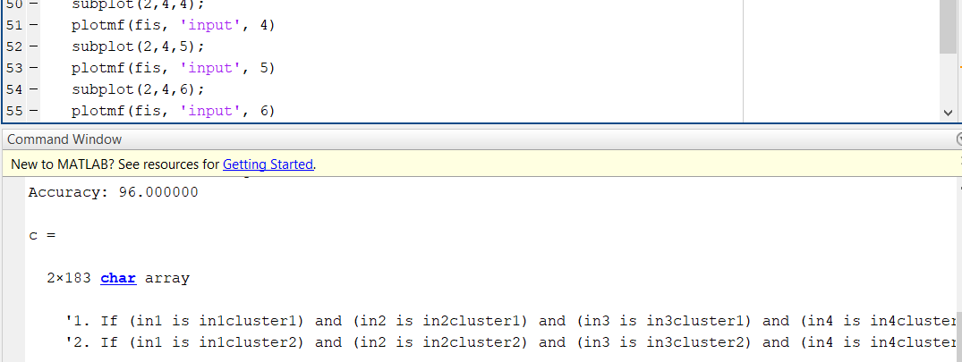
Results of FIS with FCM clustering
Screenshot of output

Slide 27
Neural Network
Neural network is an artificial intelligence technique that mimics the operation of the human brain (nerves and neurons), and comprises of densely interconnected computer processors working simultaneously (in parallel). A key feature of neural networks is that they are programmed to 'learn' by shifting data repeatedly, looking for relationships to build mathematical models, and automatically correcting these models to refine them continuously.
There are mainly two types of neural networks based on the number of hidden layers. They are:
Shallow Neural Network (Non-Deep Neural Networks).
Deep Neural Network.

Slide 28
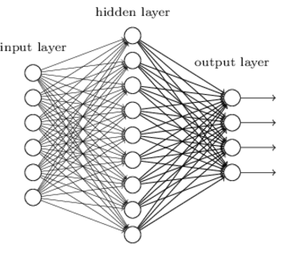
Shallow neural Network
A neural network with one hidden layer is termed as shallow network. The following is an example of shallow neural network.

Slide 29
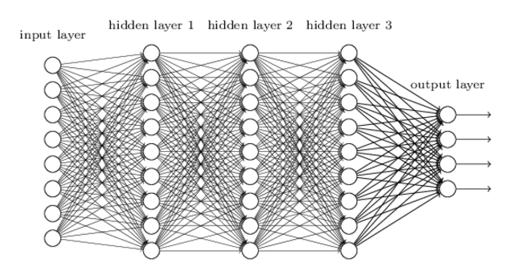
Deep Neural Network
A neural network with many hidden layers is known as a deep network. Many hidden layers, hence the name deep. The following is the example of deep neural network.

Slide 30
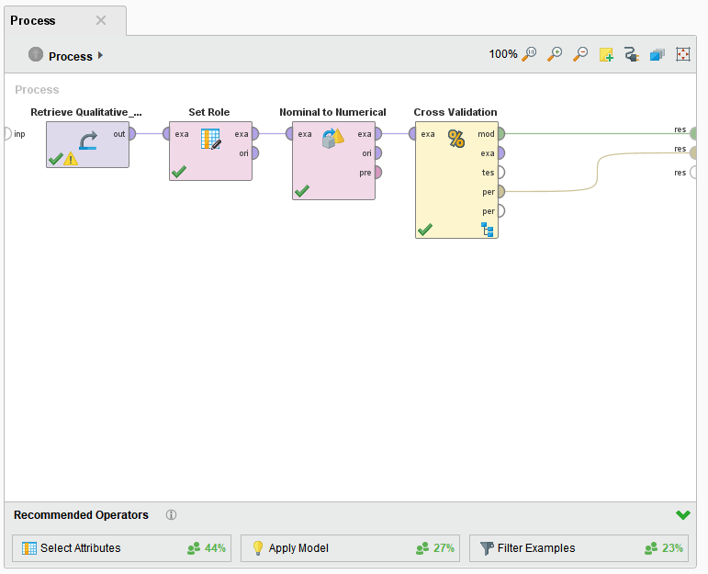

Slide 31
Results
A confusion matrix of prediction is output.
Probability of Detection (PD), also called recall or specificity, is defined as the probability of correct classification of a module that contains a fault.
PD = TP / (TP + FN)
Probability of False Alarms (PF) is defined as the ratio of false positives to all non defect modules.
PF = FP / (FP + TN)

Slide 32
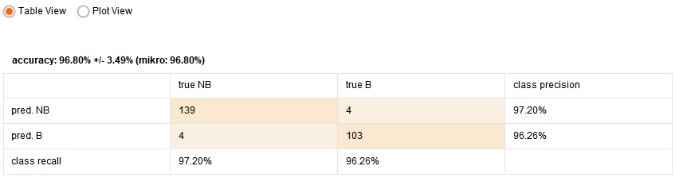
Results
We are able to get good results using neural network.
The following is the result obtained.
Accuracy ~ 96.80

Slide 33
Comparison of Results
The following are the results obtained from the various methods used.
Method | Accuracy
FIS using Fuzzy C-Means classifier | 96
Neural networks | 96.8

Slide 34
Future work
Improve the prediction of models using huge amount of data to build much accurate model
Using this system, we can alert banks/financial organizations about the chances of bankruptcy
Check the accuracy using other techniques like linear regression, Random forests, etc.

Slide 35
References
https://www.marksmannet.com/RobertMarks/Classes/ENGR5358/Papers/Zadeh1965/ZadehPaper65.pdf
https://www.sciencedirect.com/science/article/pii/S0957417403001027
https://archive.ics.uci.edu/ml/datasets/qualitative_bankruptcy
https://ieeexplore.ieee.org/document/935101
Mamdani, E.H. and S. Assilian, "An experiment in linguistic synthesis with a fuzzy logic controller," International Journal of Man-Machine Studies, Vol. 7, No. 1, pp. 1-13, 1975.

Slide 36
Thank you

